Slide 1

OUR Immune System
The war is on..

Slide 2
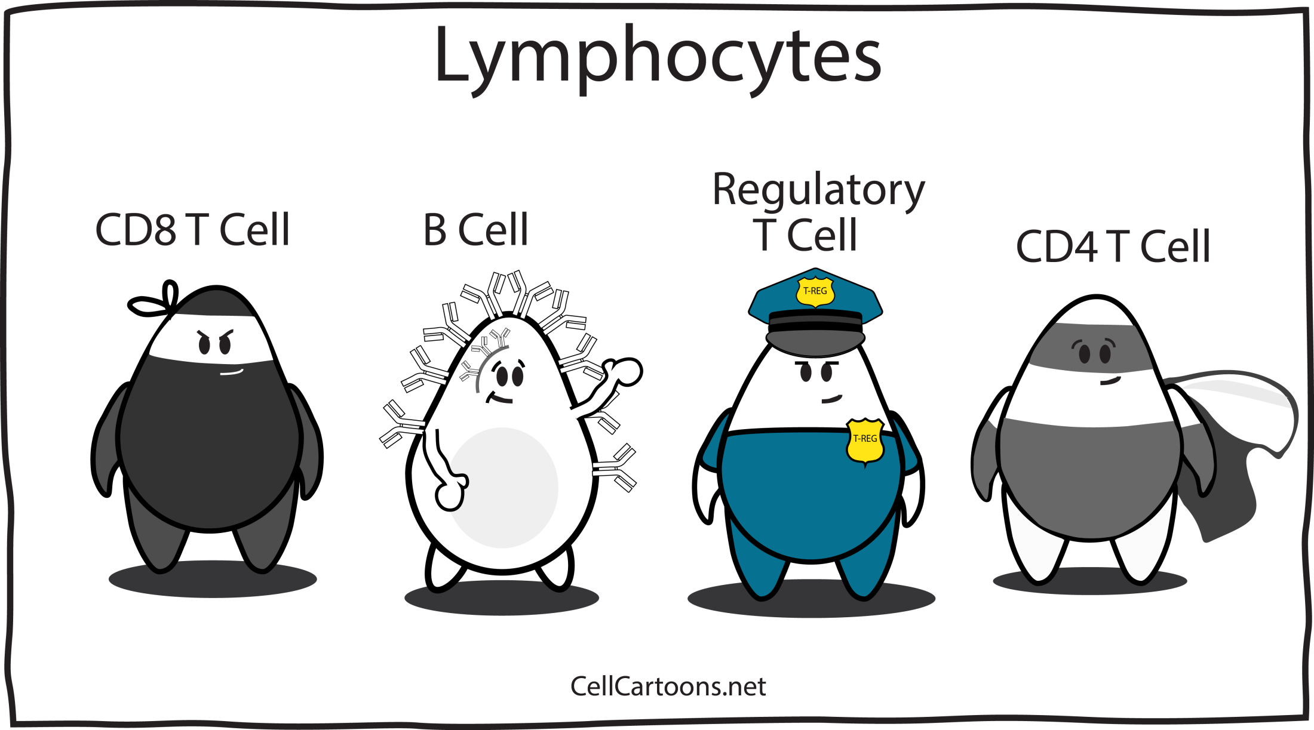

Slide 3
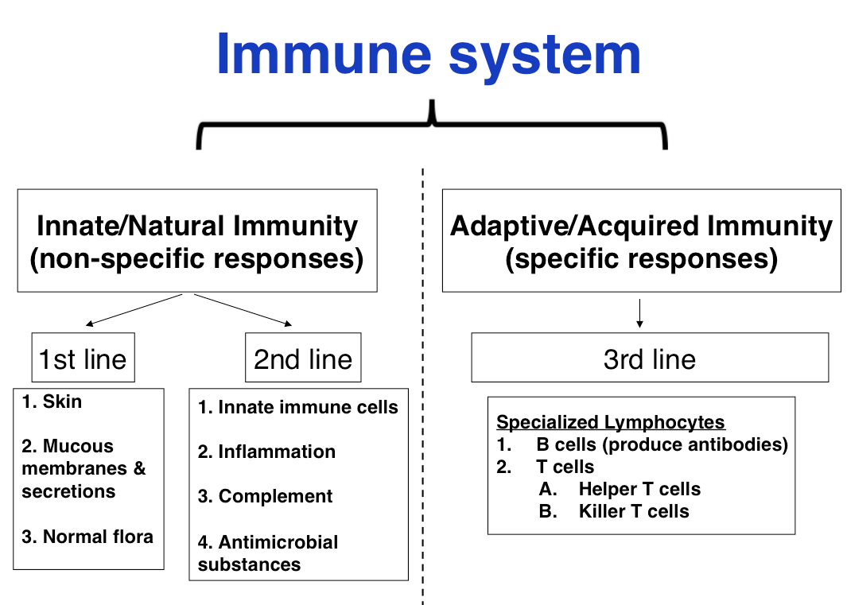

Slide 4
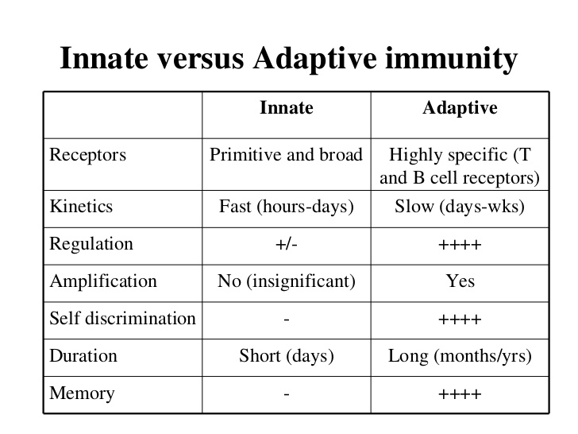

Slide 5
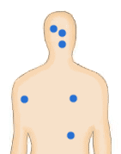

Organs involved in Innate immunity
Eyes
Tears wash out pathogens and also contain an enzyme that can kill bacteria.
Nose
Mucus traps pathogens
which are then swallowed or
blown out in coughs and sneezes.
Skin
The outer layer of skin is dead and difficult for pathogens to grow on or penetrate. Cuts allow pathogen to gain entry to the body.
Mouth
Friendly bacteria help to
prevent the growth of harmful
Stomach
pathogens. Saliva cleans and removes bacteria.
Acid helps to sterilize the food.
Lungs
Mucus in the lungs traps bacteria and fungal spores. Tiny hairs, called cilia, move the mucus to the back of the throat where it is swallowed.
Large intestine
Friendly bacteria help to stop
Reproductive system
the growth of
harmful contains
pathogens. Faeces over 30% live bacteria.
Slightly acid conditions in the vagina and urethra help to stop the growth of pathogens.
Organs involved in innate immunity

Slide 6











Innate Immune response
Innate Immune response
Includes following barriers
Anatomic
Physiologic
Phagocytic
Inflammatory
These four types of barriers help to prevent our body from the entrance and establishment of infectious agents.

Slide 7
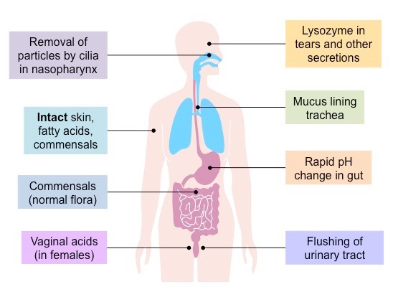
First Line of Defense
This is a mechanical barrier that protects the body from all types of pathogens
Acidic pH of Skin secretions
Stomach mucosa secretes HCl, traps bacteria
Saliva contains lysozymes that kill bacteria
Mucous lining to gastrointestinal, Urinary, reproductive tracts

Slide 8
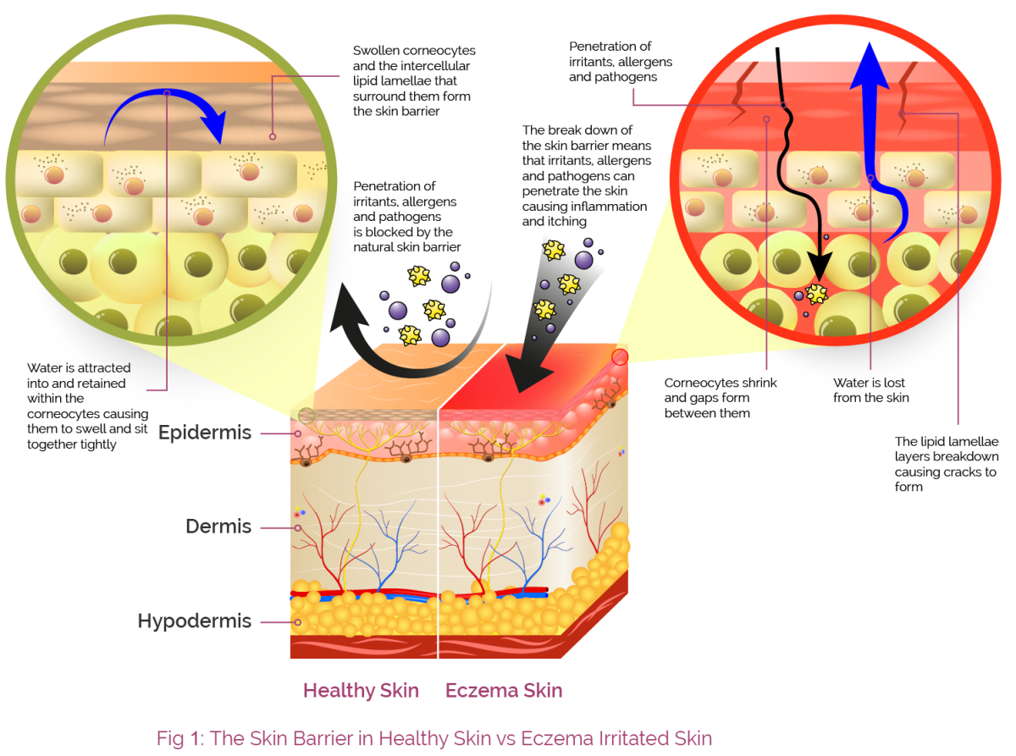

Slide 9
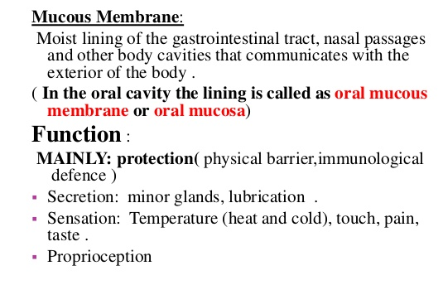
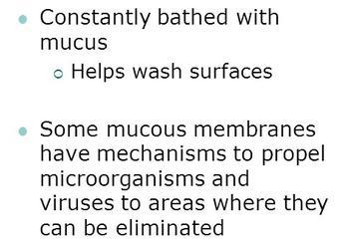

Slide 10
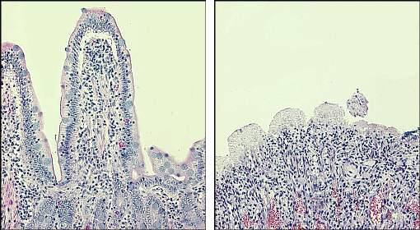
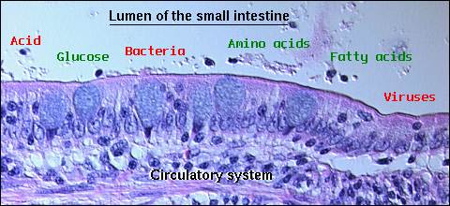

Slide 11

S.No. | Type | Mechanism
A. Anatomic barriers
1. | Skin | Mechanical barriers retards entry of microbes. Acidic environment (pH 3-5) retards growth of microbes.
2. | Mucous membranes | Normal flora compete with microbes for attachment sites and nutrients. Mucus entraps foreign microorganisms. Cilia propel microorganisms out of body.

Slide 12

S.No. | Type | Mechanism
B. Physiologic barriers
1. | Temperature | Normal body temperature inhibits growth of some pathogens. Fever response inhibits growth of some pathogens.
2. | Low pH | Acidity of stomach contents kills most ingested microorganisms.
3. | Chemical mediators | Lysozyme cleaves bacterial cell wall. Interferon induces antiviral state in uninfected cells. Complement lyses microorganisms or facilitates phagocytosis.

Slide 13


S.No. | Type | Mechanism
C. Phagocytic or Endocytic barriers
1. | Various cells internalize and break down foreign macromolecules. Specialized cells (blood monocytes, neutrophils, tissue macrophages) phagocytose, kill, and digest whole microorganisms.
D. Inflammatory barriers
1. | Tissue damage and infection induce leakage of vascular fluid, containing serum proteins with antibacterial activity, and influx of phagocytic cells into the affected area.

Slide 14










Phagocytic Barriers
Phagocytosis is one type of endocytosis. Other forms of endocytosis are:
Receptor Mediated endocytosis
Extracellular molecules are internalized after binding by specific cellular receptors.
Endocytosis
Pinocytosis
Cells take up fluid from the surrounding medium and many molecules contained in it. It involves nonspecific cell invagination.

Slide 15
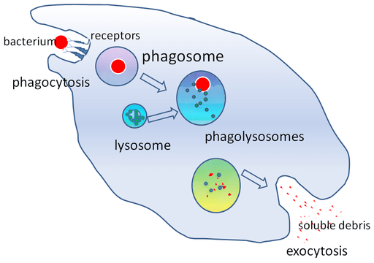
Phagocytosis
Engulfment of bacteria by Cells.

Slide 16
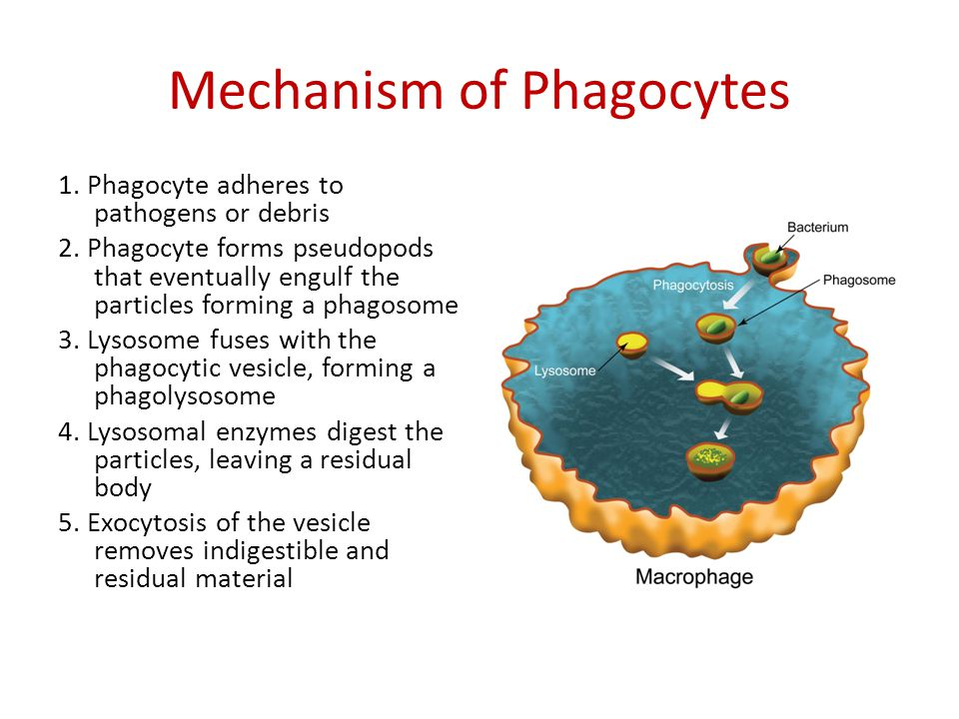

Slide 17
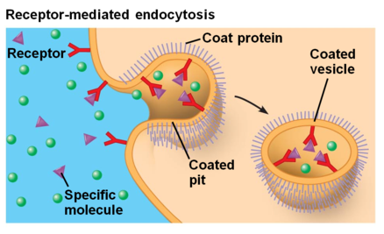
Process by which cells absorb molecules using receptor proteins

Slide 18
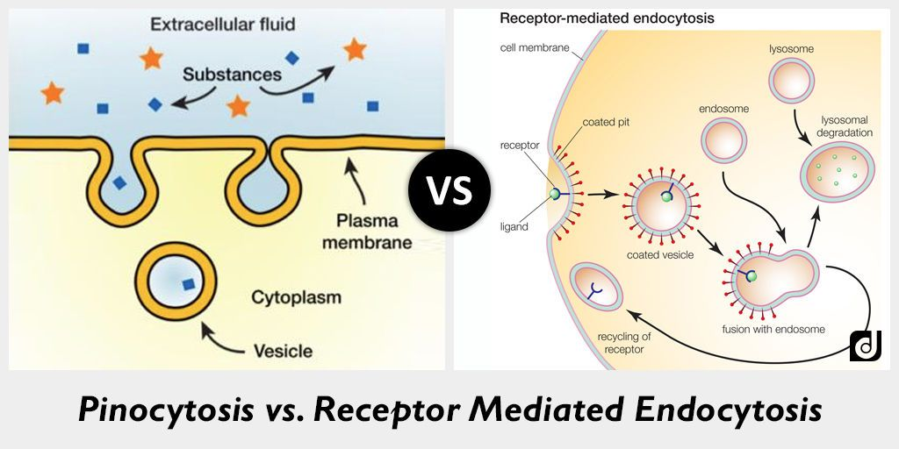

Slide 19
Inflammatory Barriers
The event in the inflammatory response are initiated by :
Tissue damage and infection induce leakage of vascular fluid, containing serum protein (acute phase proteins, e.g. c-reactive protein) with antibacterial activity, and influx of phagocytic cells into the affected area.
Chemical mediators of inflammatory responses are histamine, kinins (bradykinin, stimulates pain receptor in skin).

Slide 20
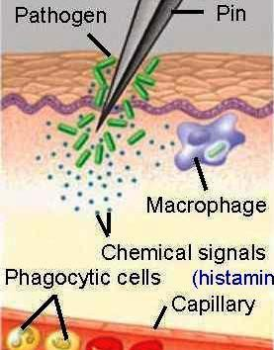
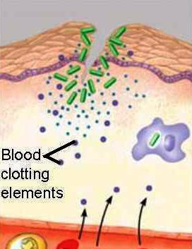
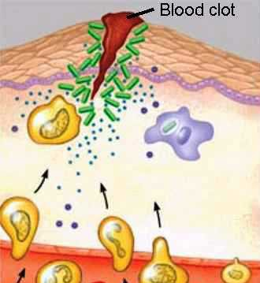
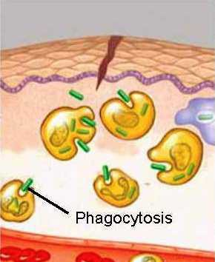




Stages of Inflammation
Chemical signals released by activated macrophages and mast cells at the injury site cause near by capillaries to widen and become more permeable.
Fluid, antimicrobial proteins and blood clotting elements move from the blood to the site.
Clotting begins.
Chemokines released by various kinds of cells attract more phagocytic cells from the blood to the injury site.
Neutrophils and macrophages phagocytose pathogens and cells debris at the site, and the tissue heals.

Slide 21
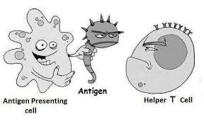
Antigen Presentation
Antigen presentation is the process by which protein antigen is presented to lymphocytes in the form of short peptide fragments. These are associated with antigen-presenting molecules such as MHC class I or MHC class II on the surface of antigen-presenting cells (APCs).

Slide 22
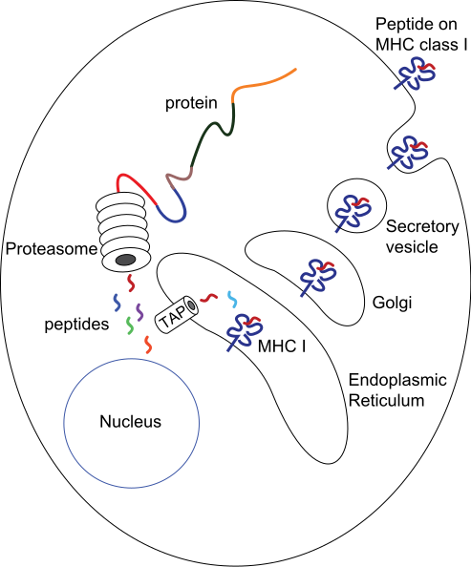
Process of Antigen Presentation

Slide 23
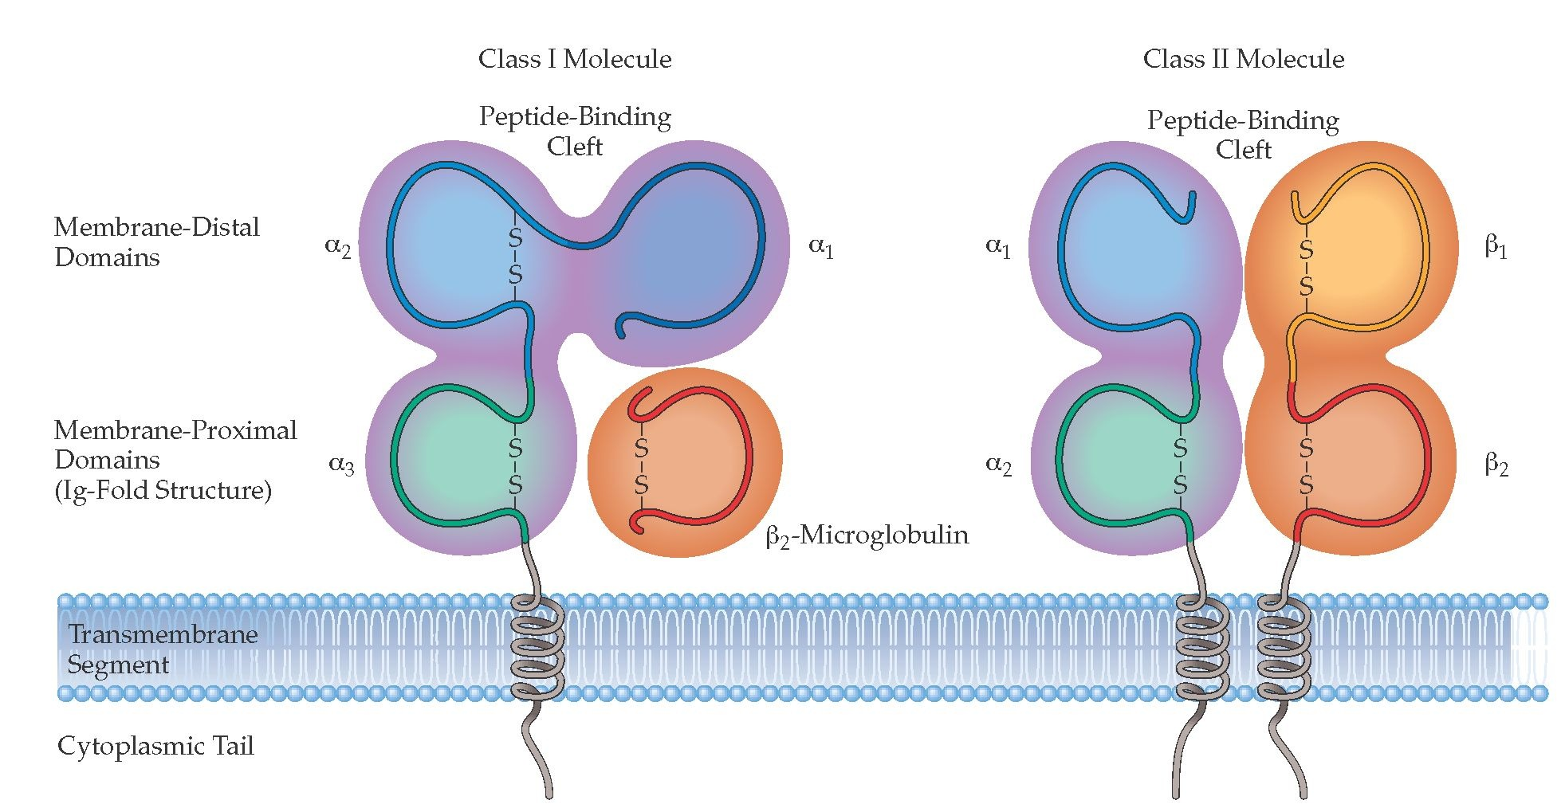
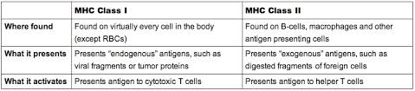

Slide 24
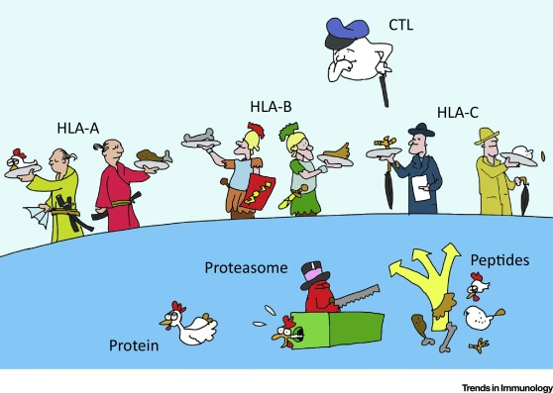
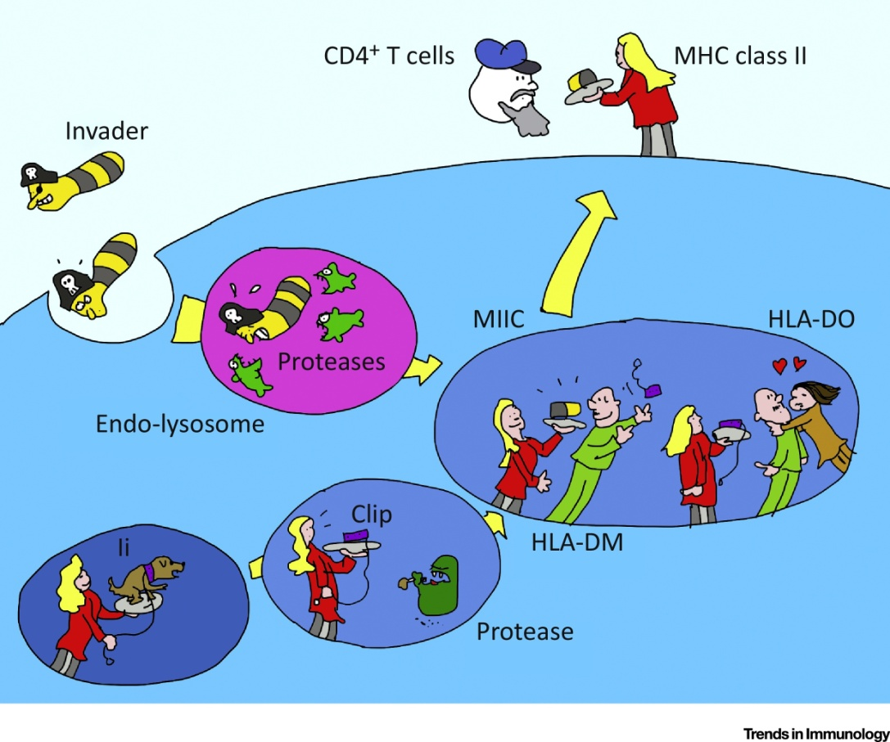
Endogenous antigen presentation
Exogenous antigen presentation

Slide 25
